Slide 1
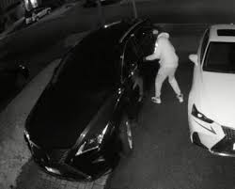
Vehicle Theft
Recognition with
Attention Models
PRESENTATION
PRESENTED BY:
STUDENT ID:
DATE:
KANG HONG
1256161
2024-08-08

Slide 2
PRESENTATION OUTLINE
Introduction
Spatiotemporal Strategy
Implementation
Problems and Solutions
Results
Conclusion
Q&A

Slide 3
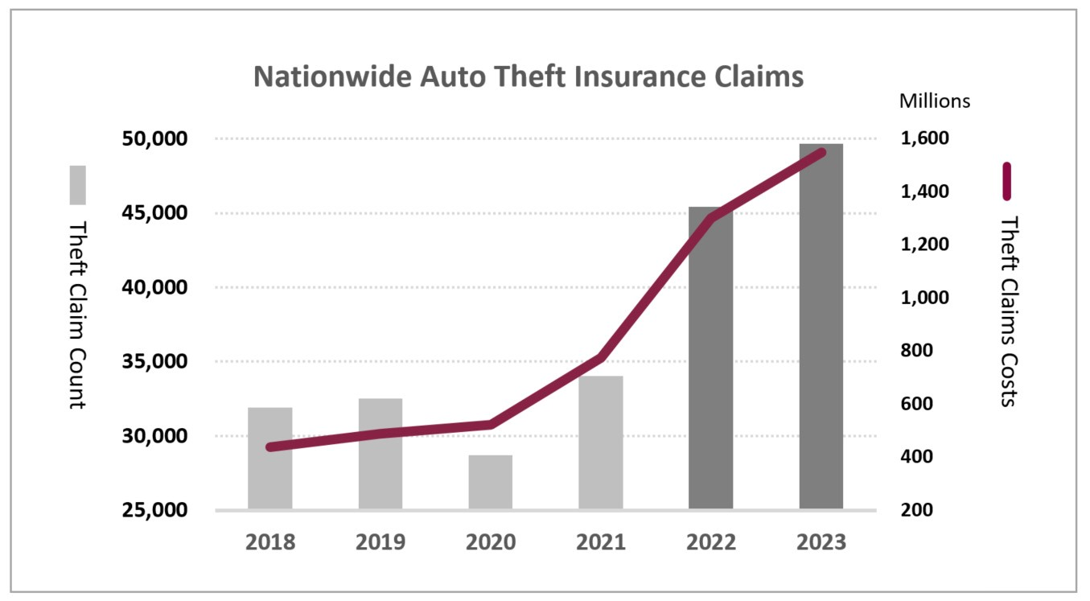
INTRODUCTION
Vehicle theft remains a significant issue in Canada
Between 2018 and 2023
theft claims cost increased by 254%
claims count increased by 56%
In 2023,
theft claims has an increase of 19% from 2022
claims count increased by 10%

Slide 4
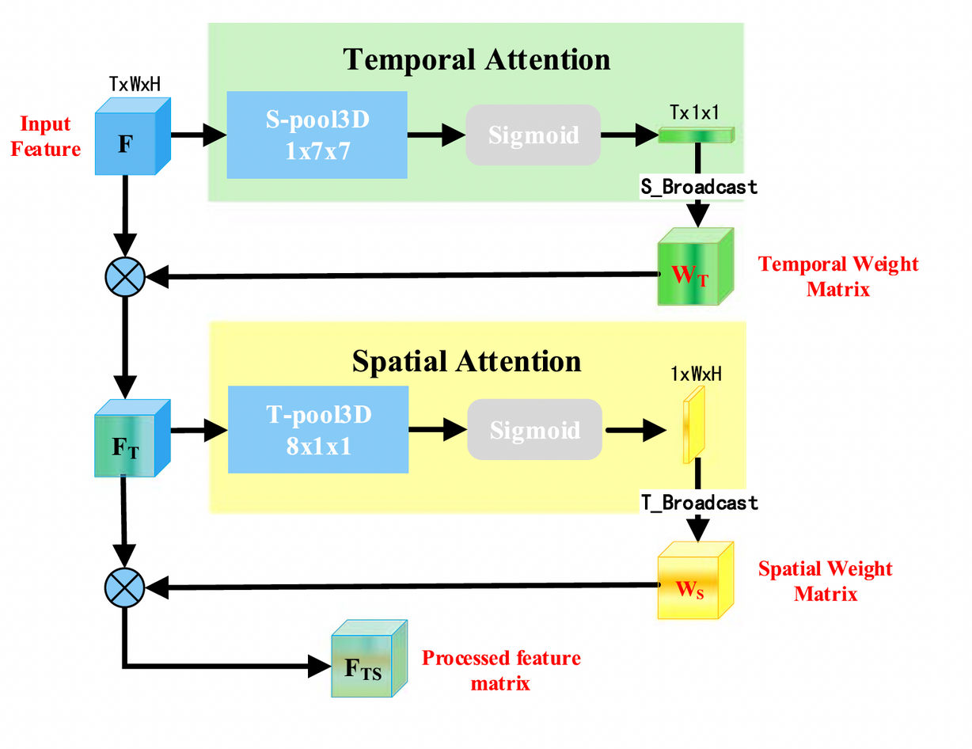
SPATIOTEMPORAL STRATEGY
To analyze and process data that has both
spatial (space-related)
and
temporal (time-related)
dimensions.
video analysis
action recognition
time-series forecasting
(appearance, movement over time)

Slide 5
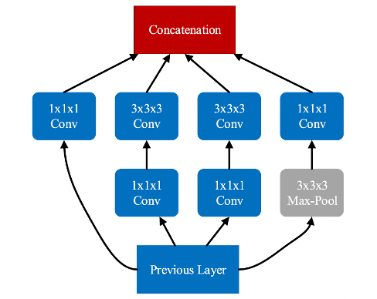
INCEPTION3D NETWORK
take a sequence of video frames as input and apply multiple 3D convolution and pooling operations in parallel.
one might focus on reducing dimensionality, another on capturing fine details across time, and another on broader patterns.
the outputs of all these operations are concatenated, creating a rich feature map that contains information at various levels of abstraction, both spatially and temporally.

Slide 6
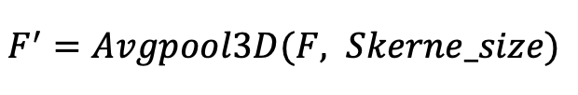
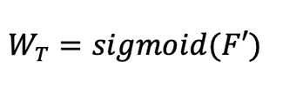
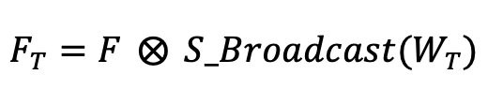
SPATIOTEMPORAL STRATEGY
Temporal Attention
the 3D features F extracted by the Inception3D network will be first input into S-pool3D module, in which the 3-dimensional average pooling method is used.
the 3D features F are reduced in the spatial dimension and the information in the time dimension is retained.
Point Multiplication Operation for Temporal Weight Assignment

Slide 7
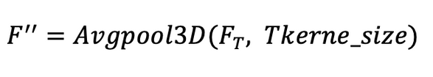

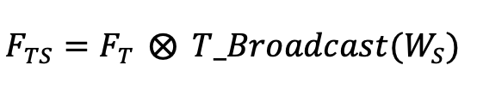
SPATIOTEMPORAL STRATEGY
Spatial Attention
the feature matrix obtained through temporal attention is reduced in the time dimension while the information in the spatial dimension is retained.
Point Multiplication Operation for Spatiotemporal Weight Allocation

Slide 8
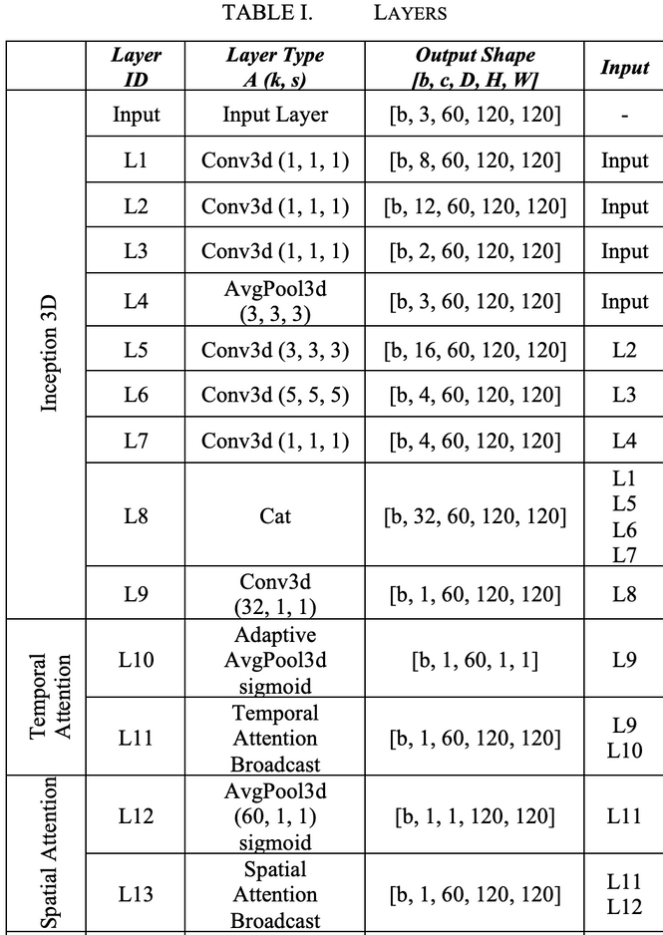
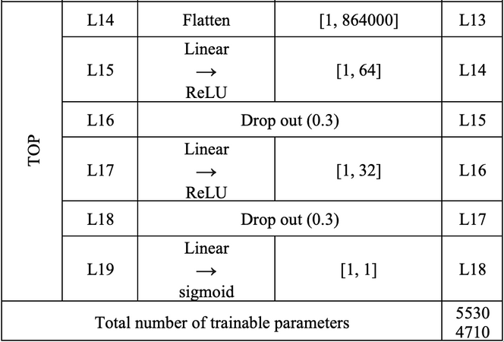
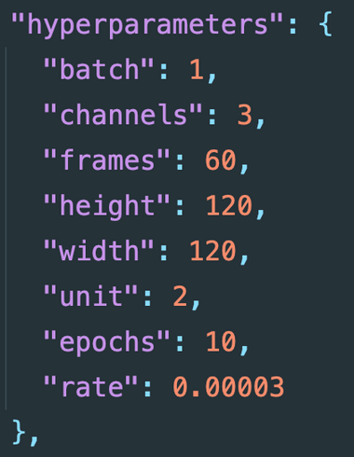
IMPLEMENTATION
Loss Function:

Slide 9
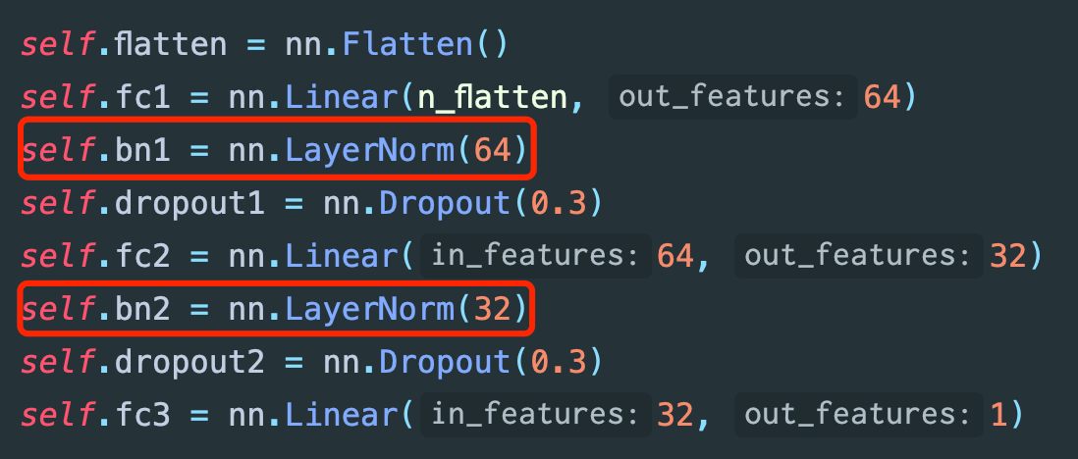
PROBLEMS AND SOLUTIONS
1. The training results stop changing after a few epochs.
Guess: Sigmoid Gradient Vanishing
Solution: LayerNorm
Result: Fixed

Slide 10
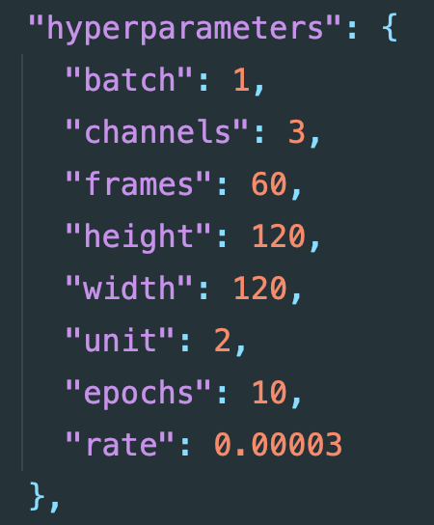
PROBLEMS AND SOLUTIONS
2. The training results oscillate around a certain value.
Guess: Learning rate is too high
Solution: Reduce Learning Rate
Result: Fixed

Slide 11
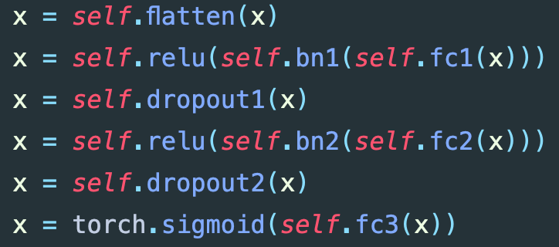
PROBLEMS AND SOLUTIONS
3. Big gap between training results and validation results
Guess: Overfitting
Solution: Add Dropouts
Result: Fixed

Slide 12
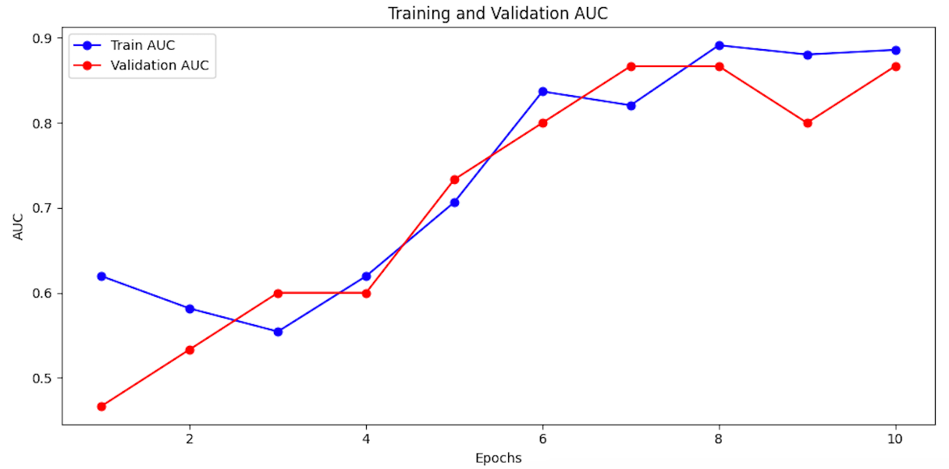
RESULTS

Slide 13
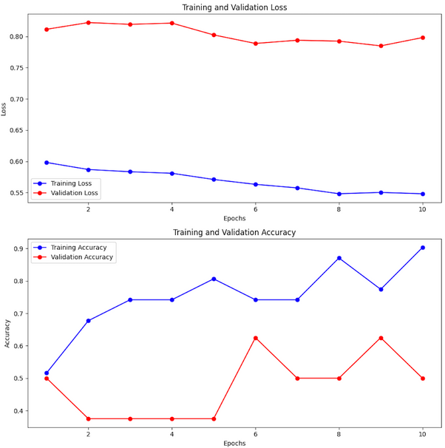
RESULTS (HOWEVER)
Loss and Accuracy measurements are not beautiful
The training results are not stable enough.
The main reason is likely the lack of training data; currently, there are only 25 vehicle theft videos and 13 non-theft videos.

Slide 14
CONCLUSION
Through continuous parameter tuning, an improvement in AUC was achieved, which to some extent indicates the correctness of the model. However, the training results are unstable, and accuracy needs to be improved. This is largely due to the lack of training data. Overall, this is a successful attempt.

Slide 15
Q&A
Get code in:
https://github.com/mylakehead/deep-learning
The spatial-temporal attention mechanism can be applied to many action recognition scenarios. If you're interested, you can check out and improve this implementation. By replacing the FNN, it can be adapted for multi-class classification scenarios.

